Slide 1
Introduction to eSight 21.0 HNMS
Security Level:

Slide 2
Upon completion of this course, you will be able to:
Be familiar with HNMS features.
Be familiar with HNMS interconnection configuration.
Understand routine HNMS O&M.

Slide 3
1
Overview
2
Interconnection Configuration
3
Routine O&M

Slide 4
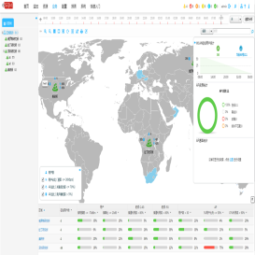

HNMS Overview
Positioning of upper-layer NMSs
Provides network O&M functions for the upper-layer network to centrally monitor and display aggregated information about the entire network to meet hierarchical management requirements.
Key features
Upper-layer and lower-layer interconnection management
Centralized resource display
Centralized alarm display
Centralized monitoring portal
Upper-layer NMS
Aggregated information
Periodically synchronizes all data from lower-layer NMSs.
Receives change events from lower-layer NMSs and synchronizes differential data.
REST HTTPS security channel
Lower-layer NMS
Lower-layer NMS
Lower-layer NMS
Lower-layer NMS

Slide 5
1
Overview
2
Interconnection Configuration
3
Routine O&M

Slide 6
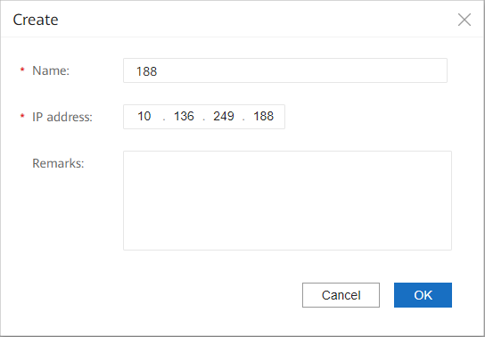
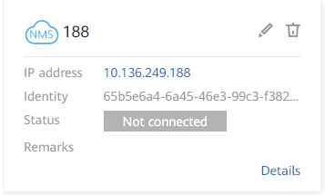
Creating Lower-Layer NMSs on an Upper-Layer NMS
On an upper-layer NMS, choose System Management > System Settings > Lower-Layer NMS to create a lower-layer NMS.
After a lower-layer NMS is created, a lower-layer NMS ID is generated. An upper-layer NMS supports a maximum of 200 lower-layer NMSs.

Slide 7
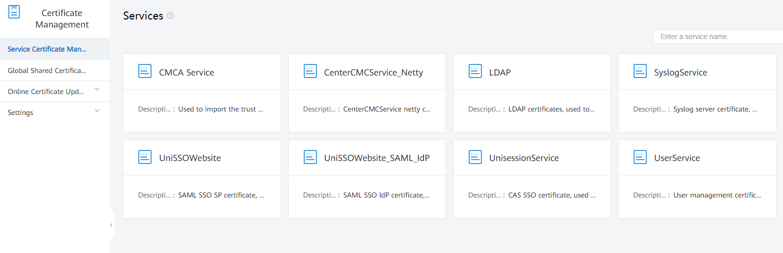
Import the Communication Certificate to an Upper-Layer NMS
On an upper-layer NMS, choose System Management > Certificate > Service Certificate to import the identity certificate and trust certificate required for communication with lower-layer NMSs.
For security purposes, you need to prepare the communication certificates for two-way authentication between upper-layer and lower-layer NMSs. (You can use the configuration item management function to disable certificate authentication. If certificate authentication is disabled on an upper-layer NMS, certificate authentication must be disabled on all lower-layer NMSs connected to the upper-layer NMS.)

Slide 8
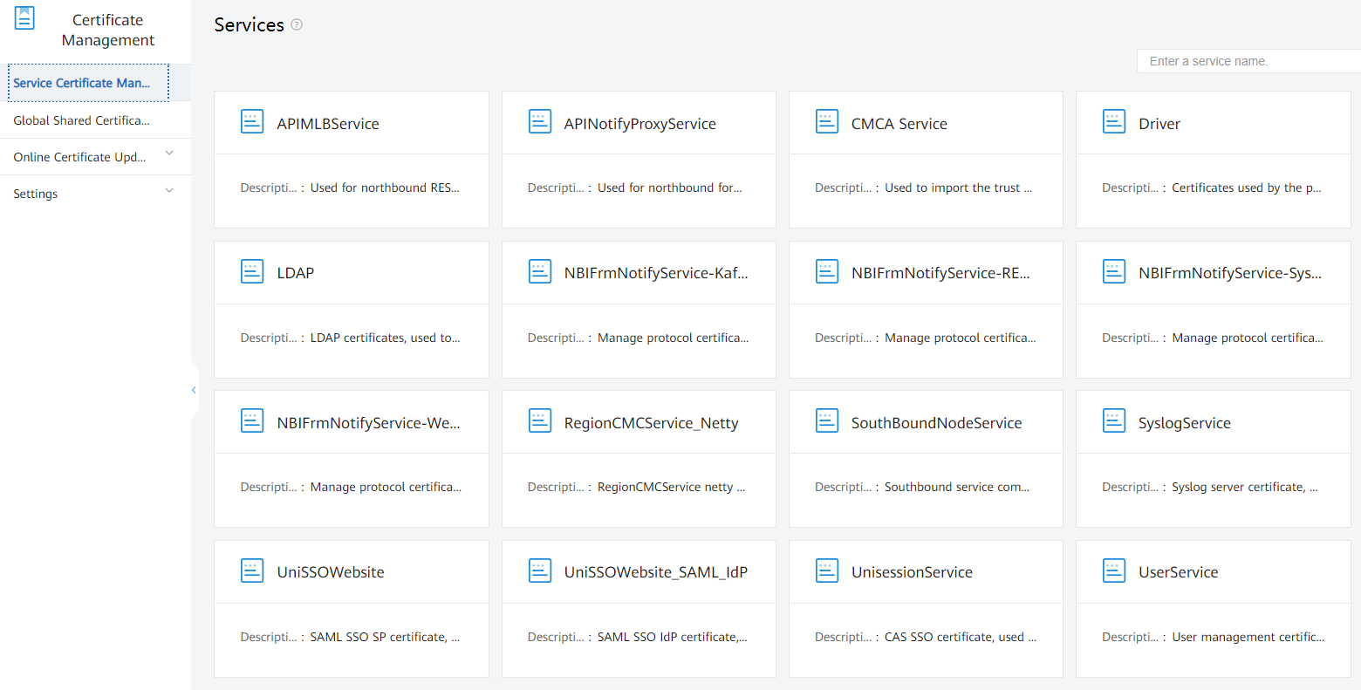
Import the Communication Certificate to a Lower-Layer NMS
On a lower-layer NMS, choose System Management > Certificate > Service Certificate to import the identity certificate and trust certificate required for communication with upper-layer NMSs.
For security purposes, you need to prepare the communication certificates for two-way authentication between upper-layer and lower-layer NMSs. (You can use the configuration item management function to disable certificate authentication. If certificate authentication is disabled on a lower-layer NMS, certificate authentication must be disabled on the upper-layer NMSs.)

Slide 9
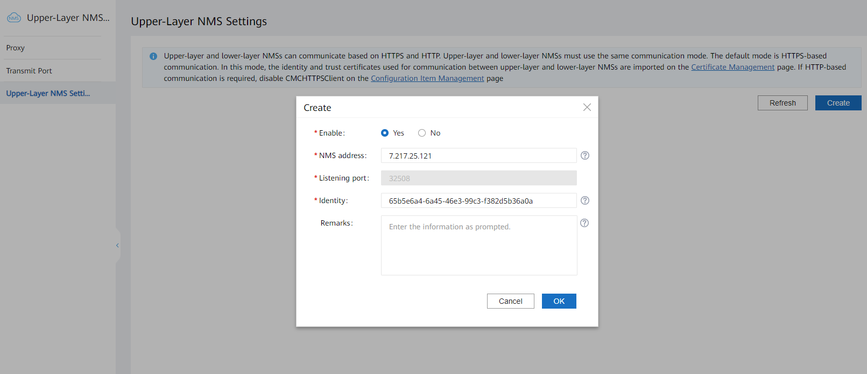
Configuring an Upper-Layer NMS on a Lower-Layer NMS
Choose System Management > System Settings > Upper-layer NMS > Upper-layer NMS Settings on a lower-layer NMS to create an upper-layer NMS to be connected to the lower-layer NMS.
Set this parameter to the ID allocated by the upper-layer NMS.
When configuring an upper-layer NMS on a lower-layer NMS, you need to enter the ID allocated by the upper-layer NMS. After the upper-layer NMS is created, the default status is Disconnected. When the data channel between the upper-layer NMS and the lower-layer NMS is established, the status changes to Online.

Slide 10
1
Overview
2
Interconnection Configuration
3
Routine O&M

Slide 11
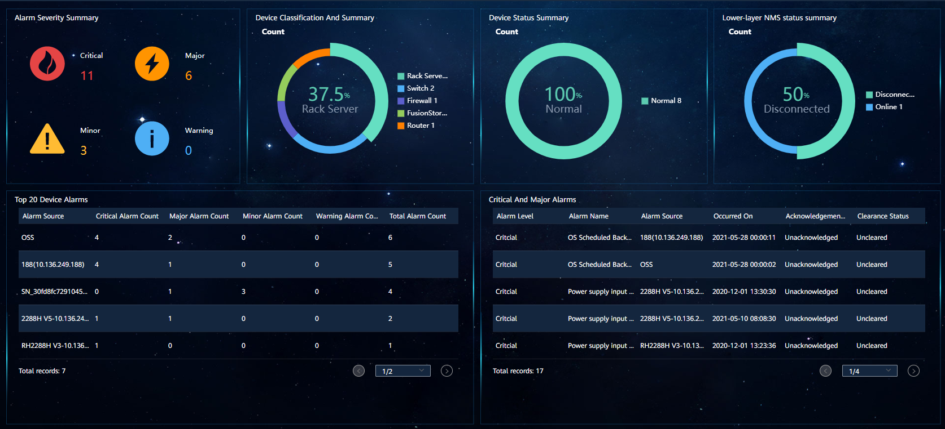
Centralized Monitoring Portal on an Upper-Layer NMS
Key information is centrally monitored. The home page displays the overview of devices and key alarm information on the entire network, helping O&M personnel quickly obtain the information overview.

Slide 12
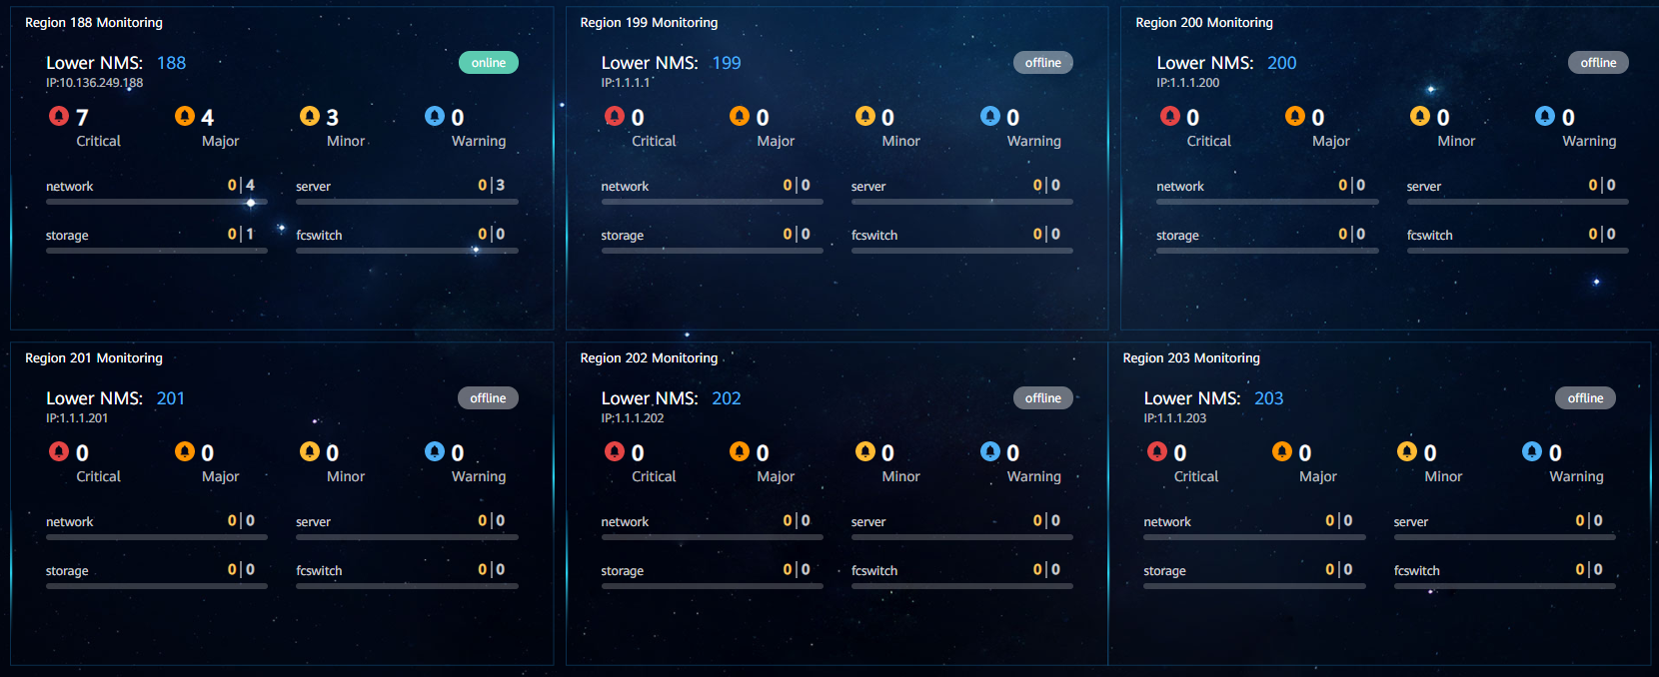
Key Lower-Layer NMS Statistics
Switch to a lower-layer NMS.
Key information about a single lower-layer NMS is displayed in cards. You can switch to the alarm or device list of the lower-layer NMS in one-click mode to view the details after filtering.

Slide 13
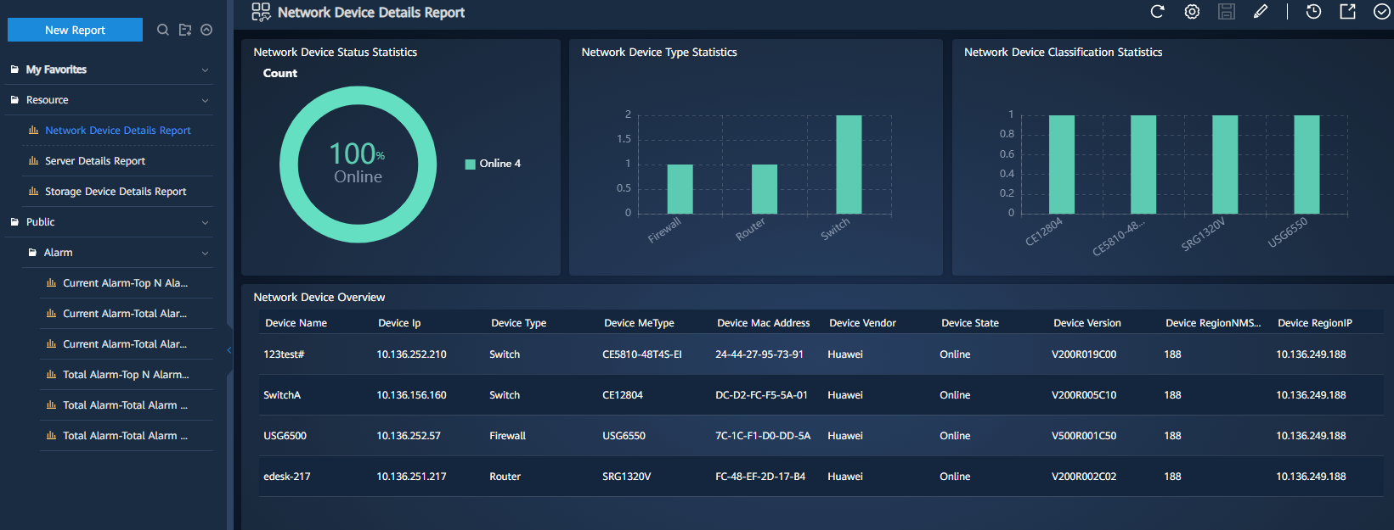
Lower-Layer NMS Resource and Alarm Report Statistics
eSight displays device details and alarm statistics on the entire network, and periodically generates reports.

Slide 14
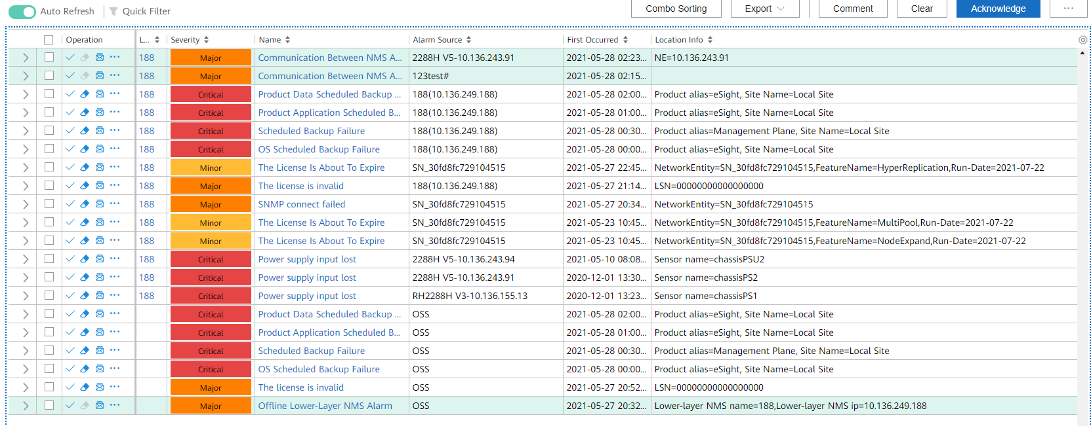
Centralized Alarm Monitoring on an Upper-Layer NMS
Switch to a lower-layer NMS.

Slide 15
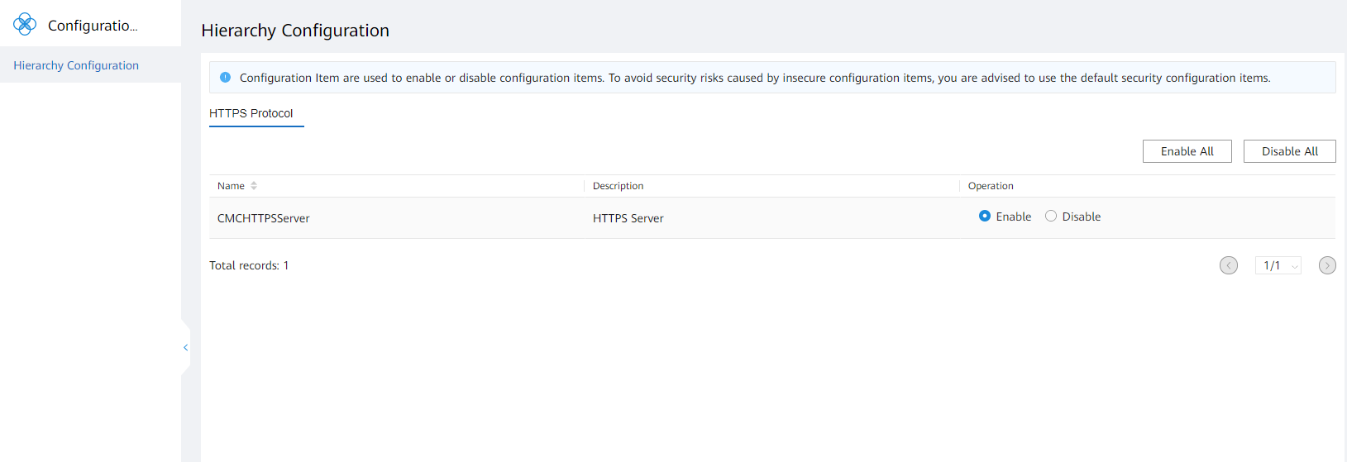
Disabling Certificate Authentication on an Upper-Layer NMS
On an upper-layer NMS, choose System Management > System Settings > Configuration Item to disable certificate authentication.
Enabled by default

Slide 16
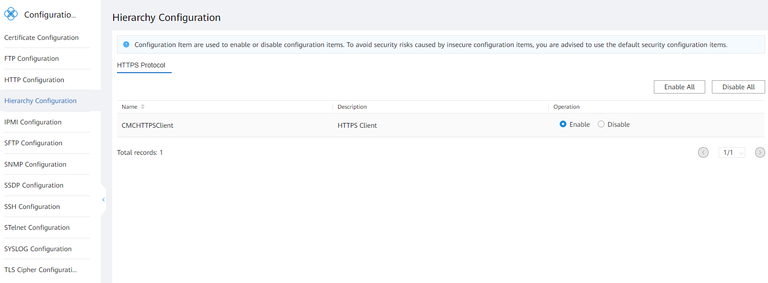
Disabling Certificate Authentication on a Lower-Layer NMS
On a lower-layer NMS, choose System Management > System Settings > Configuration Item to disable certificate authentication.
Enabled by default

